Slide 1
www.bime.org.uk
Assistive Technology to help people living with dementia.
What is available?

Slide 2
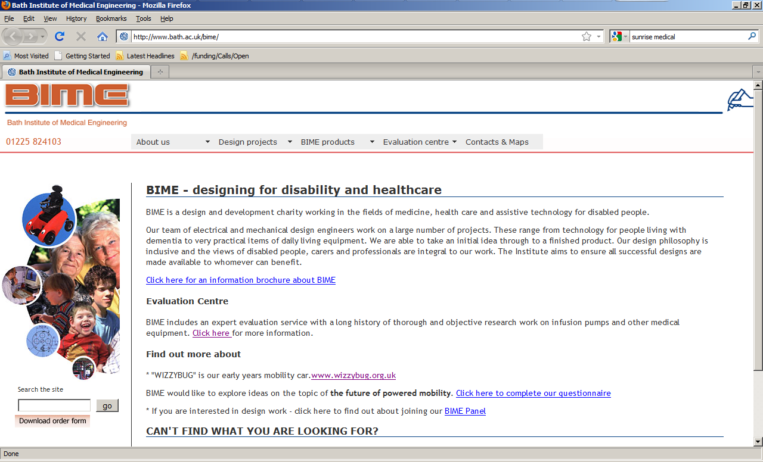
www.bime.org.uk

Slide 3
Living with dementia
Access to technology (music, TV, video)
Social activities
Lack of awareness of time of day
Self care and daily activities
Independence and safety in the kitchen
Orientation within the home
Risk of falls
Concern about leaving the flat, getting lost

Slide 4
Why use technology ?
Empowering
Promote / maintain independence
Support safety

Slide 5
Terminology
Assistive technology or aids for living
Telecare
Telehealth

Slide 6


www.dementia-signage.co.uk
FIND Telephone 0113 230 2046

Slide 7
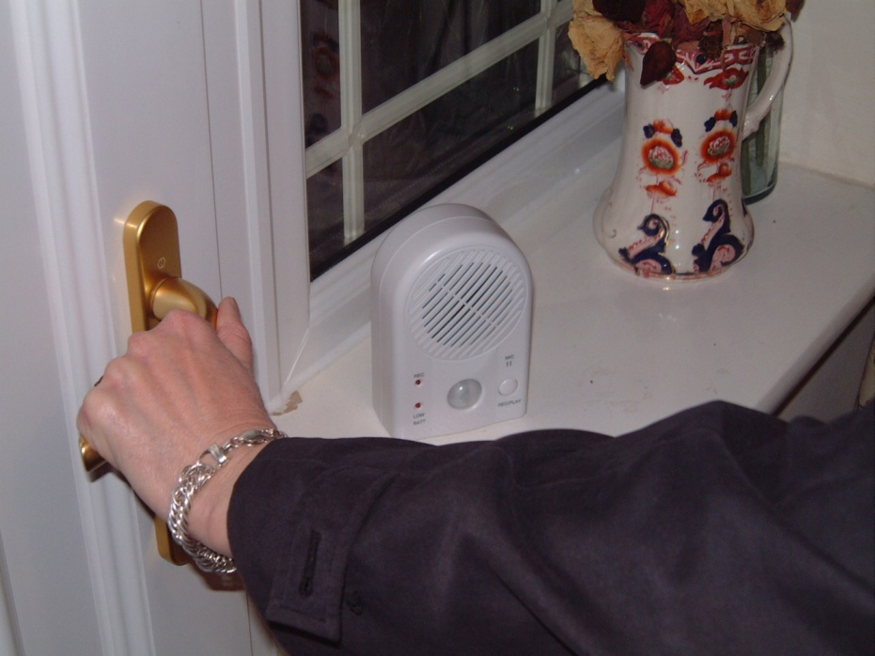
Wander Reminder

Slide 8
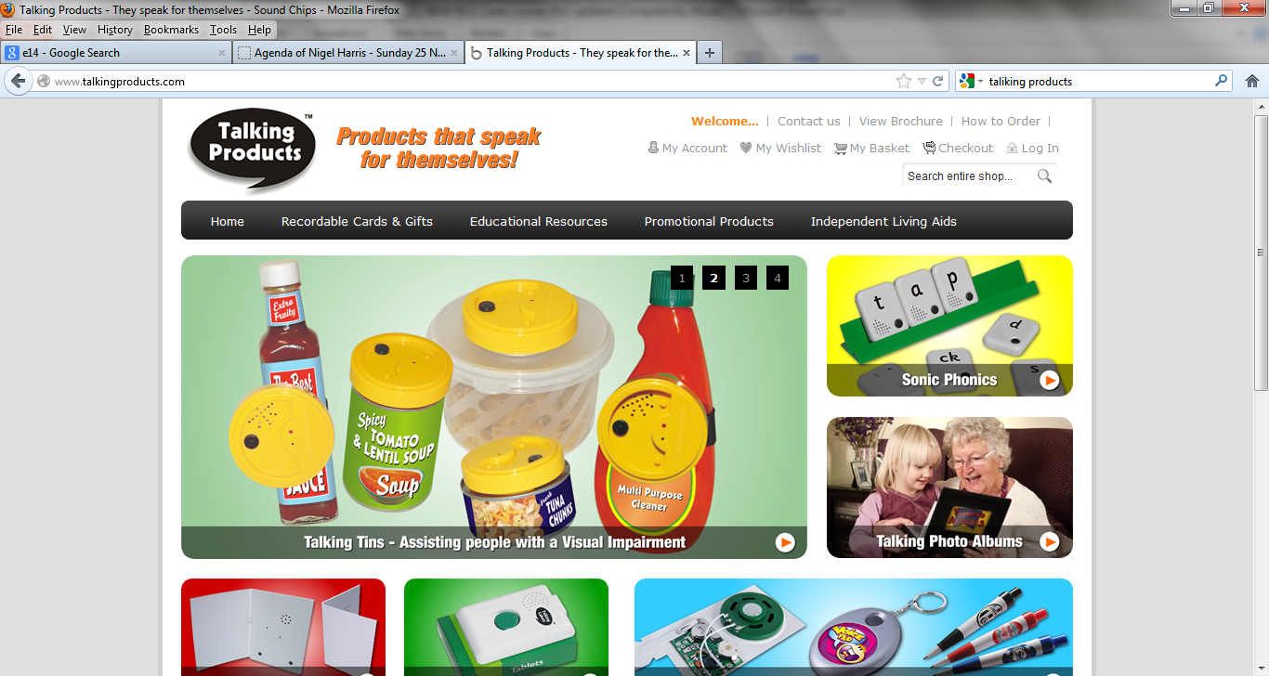
Tel: 01794 278327

Slide 9

Audio/visual scheduling
Scheduler
When it is time for an event a prompt screen is shown and an announcement made “There is a message, click on the screen to hear it”
Imesart S.a.r.l.’s Audio Memos - The Voice Recorder
https://itunes.apple.com/gb/app/audio-memos-voice-recorder/id338550388?mt=8

Slide 10
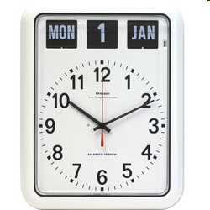
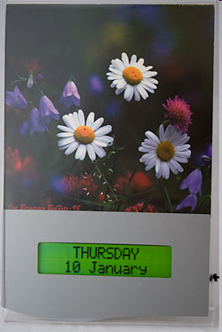
Day / Date clock / calendar
Notes:
£59.60 / £87

Slide 11

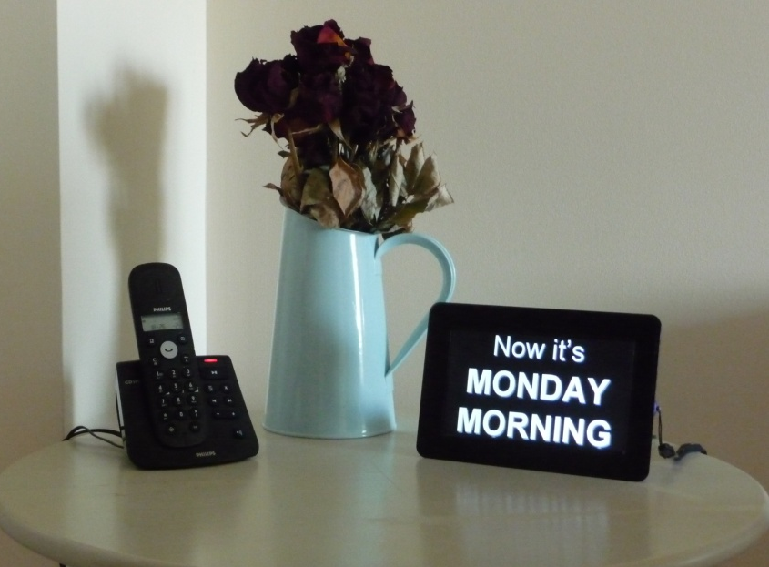
Applying existing technology
Digital Frames Direct 0117 330 2277

Slide 12
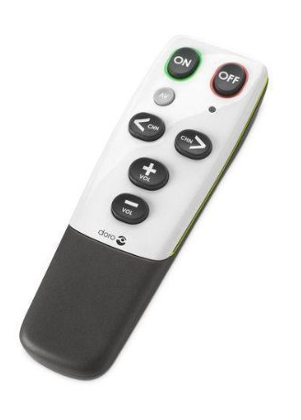
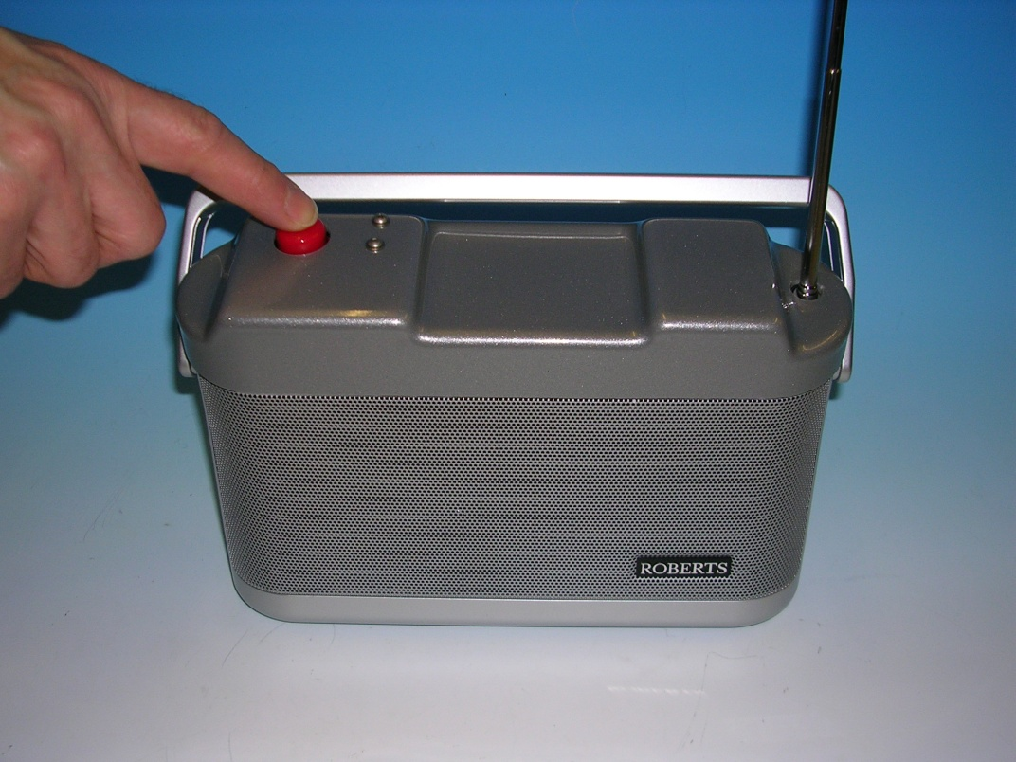
TV and Radio

Slide 13
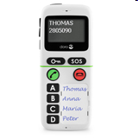
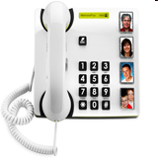
Telephones
Doro handlePlus 334 Mobile Phone
Doro Memory Plus 319

Slide 14
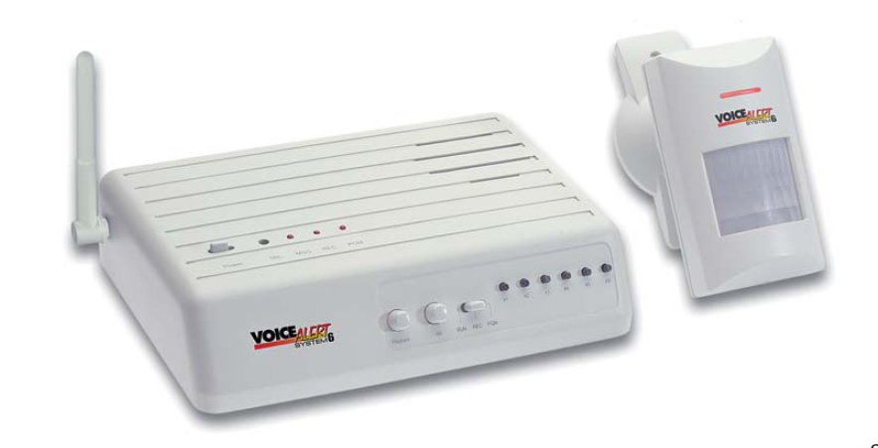
What is telecare?
Telecare is the continuous, automatic and remote monitoring of real time emergencies and lifestyle changes over time in order to manage the risks associated with independent living.’ www.telecareaware.com

Slide 15
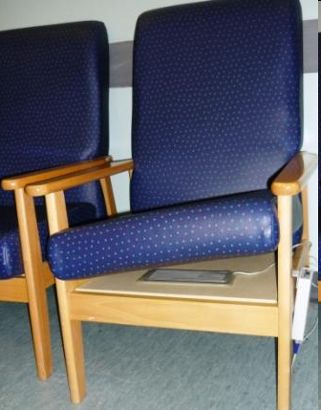
Bed and Chair Sensors
Telecare systems
Aster Living Tel: 01380 829000
email: info@asterliving.co.uk
Selwood Lifeline
01225 715715 or email: lifeline@selwoodhousing.com

Slide 16
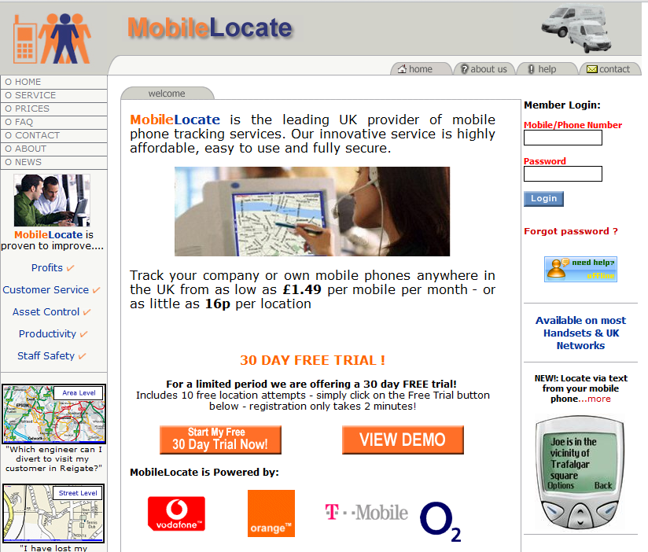

Slide 17
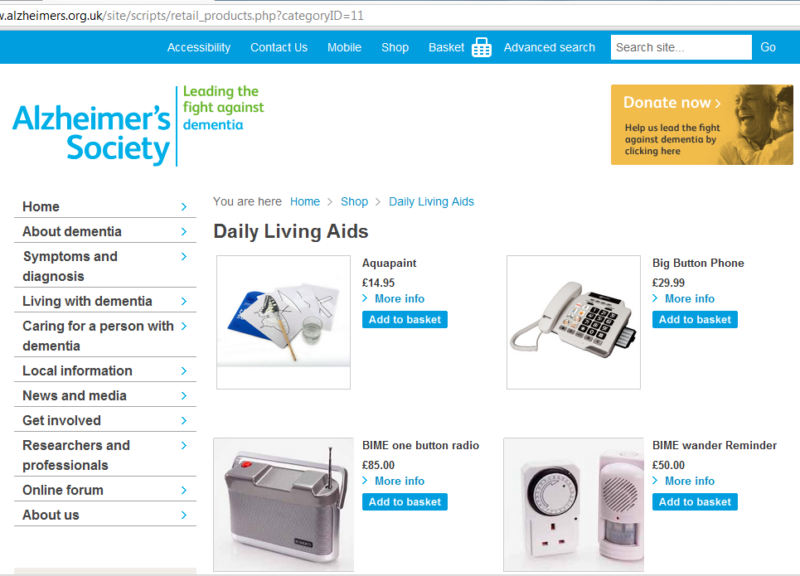

Slide 18
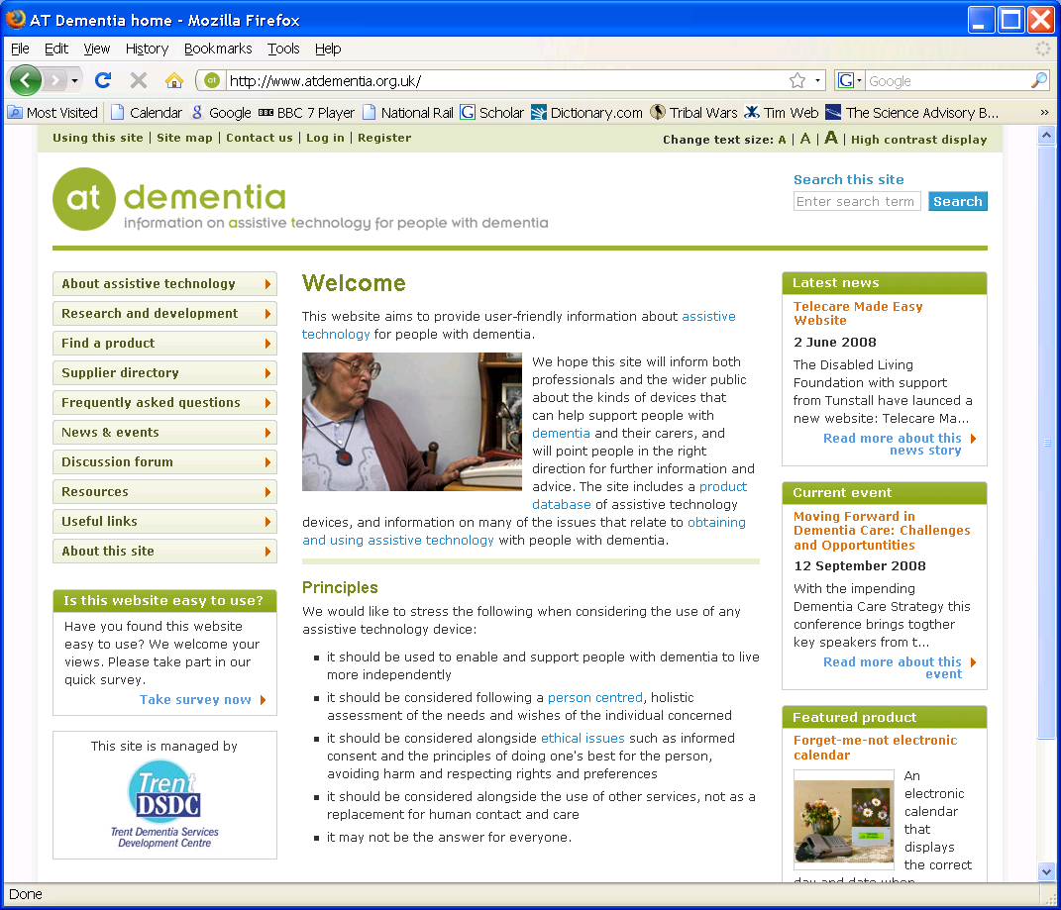
At dementia www.atdementia.org.uk

Slide 19

Disabled Living Foundation
http://www.livingmadeeasy.org.uk/telecare
Helpline: 0845 1309177
LOCAL INDEPENDENT LIVING CENTRES
Living (Bristol) TEL: 0117 965 3651
www.thisisliving.org.uk
Semington TEL: 01380 871007
www.ilc.org.uk

